Slide 1
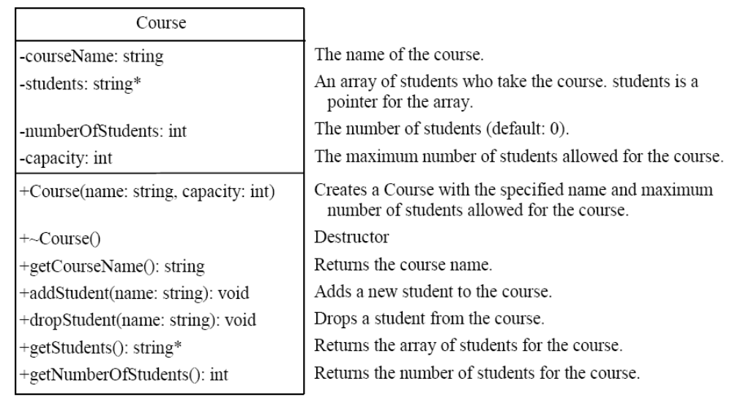
Exercise 1
Design a class for modeling course and write a test program to test it.

Slide 2
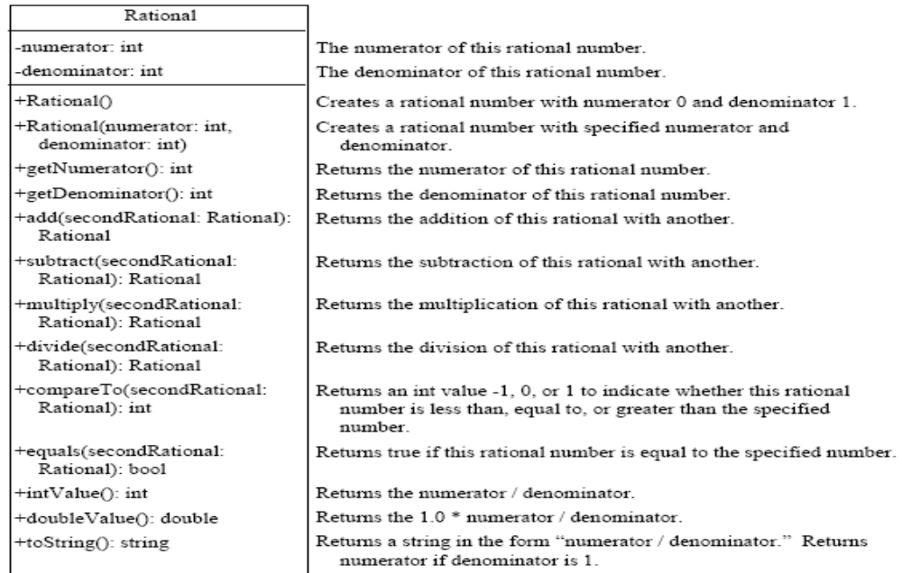
Exercise 2
Design a Rational class for modeling rational numbers and test it.

